Slide 1

Chandigarh University
Department of Mathematics
B.Tech. CSE (Core/DS/IT/CC)
Semester-3
Subject Code:25MTT-202
Discrete Mathematics
Chapter:1.3.2
Dr. SARTAJ
DISCOVER . LEARN . EMPOWER

Slide 2

CO mappings

Slide 3

CO-PO mappings
Note: Degree of relevance/correlation: 1-Low, 2-Medium, 3-High, Blank or ‘- ‘- Nil

Slide 4
Topics Covered
Introduction to Induction method
Proof by Induction method
Conclusions
Video links
References

Slide 5
Introduction to Induction method
Opening Question:
"Imagine you have an infinite staircase. If you can step onto the first stair, and if every time you’re on a stair, you can always step up to the next one.
can you reach every stair? Why or why not?"

Slide 6
Induction Method
Principle of Mathematical Induction:
To prove that P(n) is true for all positive integers n, we complete these steps:
Basis Step: Show that P(1) is true.
Assume Step: Assume that P(k) is true.
Inductive Step: Show that P(k) → P(k + 1) is true for all positive integers k.
To complete the inductive step, assuming the inductive hypothesis that P(k) holds for an arbitrary integer k, show that P(k + 1) must be true.

Slide 7
Induction Method
Important Points:
Mathematical induction can be expressed as the rule of inference-
(P(1) ∧ ∀k (P(k) → P(k + 1))) → ∀n P(n)
where the domain is the set of positive integers.
In a proof by mathematical induction, we don’t assume that P(k) is true for all positive integers! We show that if we assume that for arbitrary k, P(k) is true, then P(k + 1) must also be true.
Proofs by mathematical induction do not always start at the integer 1. In such a case, the basis step begins at a starting point b where b is an integer.

Slide 8
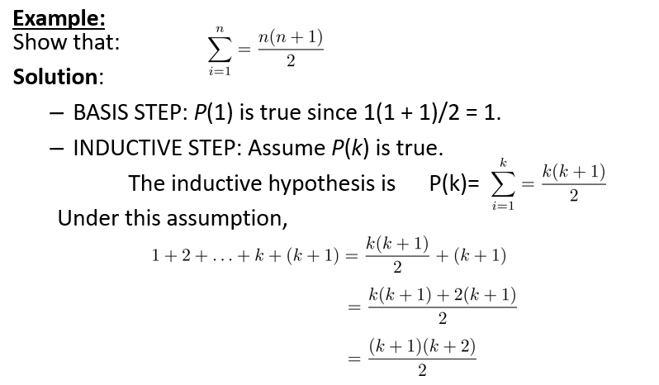
Induction Method
This shows that by induction method that P(n) is true for all values of n=1,2,3,…..

Slide 9
Induction Method
Example:
Use mathematical induction to prove that 2^{n} < n!, for every integer n ≥ 4.
Solution: Let P(n) be the proposition that 2^{n} < n!.
BASIS STEP: P(4) is true since 2⁴ = 16 < 4! = 24.
INDUCTIVE STEP: Assume P(k) holds, i.e., 2^{k} < k! for an arbitrary integer k ≥ 4. To show that P(k + 1) holds:
2^{k+1} = 2∙2^{k}
< 2∙ k! (by the inductive hypothesis)
< (k + 1)k!
= (k + 1).
Therefore, 2^{n} < n! holds, for every integer n ≥ 4.
Note that here the basis step is P(4), since P(0), P(1), P(2), and P(3) are all false.

Slide 10
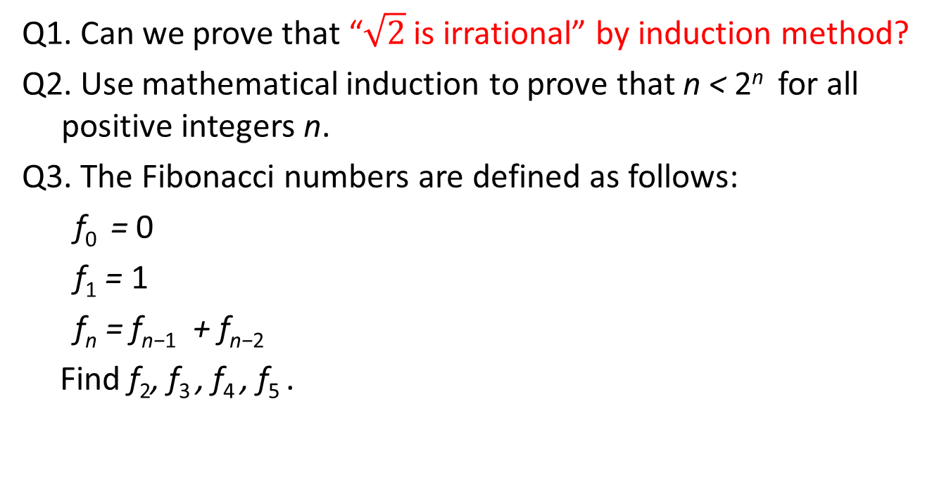
Learning Activity
Q1. Can we prove that “$\sqrt{2}$ is irrational” by induction method?
Q2. Use mathematical induction to prove that n < 2^{n} for all positive integers n.
Q3. The Fibonacci numbers are defined as follows:
f₀ = 0
f₁ = 1
f_{n} = f_{n−1} + f_{n−2}
Find f₂, f₃ , f₄ , f₅ .

Slide 11
Conclusion
We discussed induction techniques of proof.
Related applications and problems are discussed.

Slide 12
Video Links
https://youtu.be/5Hn8vUE3cBQ
https://youtu.be/wblW_M_HVQ8
https://youtu.be/0UgID8C9RvE
https://www.tutorialspoint.com/discrete_mathematics/discrete_mathematical_induction.htm

Slide 13
References
Sr. No. | Author | Name of the Book | Publisher | Year of Publication
1 | Kenneth H. Rosen | Discrete Mathematics and Its Applications | McGraw-Hill | 2019
2 | C. L. Liu | Elements of Discrete Mathematics | McGraw-Hill | 1996
3 | J. P. Tremblay, R. Manohar | Discrete Mathematical Structures with Applications to Computer Science | Tata McGraw Hill | 2001
4 | Kolman, Busby, Ross | Discrete Mathematical Structures | PHI | 2001
5 | Narsingh Deo | Graph Theory with Applications to Engineering and | PHI | 2017

Slide 14
Thanks!!!

